Slide 1


Report Out: Athletes Sport
Joyner Quan

Slide 2
Contents
Description / Review of Questions to Answer / Hypotheses / Approach
Discuss Technical Challenges
Detail: Entity Relationship Diagram (ERD)
Initial Findings
Deeper Analysis
Hypotheses Results

Slide 3
Description
Analyze the trend of medals of top 30 countries with the changing of years.
Find the relation between different countries’ performance.
The parameters like height, weight and age have effects on the outcome.

Slide 4
Questions to Answer
Is the trend of age getting younger and the trend of weight is getting larger?
The trend of age, weight and height all experienced a rise before 1920 and a drop then a rise. Average weight and average height are highly correlated, and both reached their lowest point in 1960, and then increased year by year. The decline before 1960 may be related to the world war. In the peaceful era, the height and weight of the contestants increased. These three indicators fluctuated slightly after 2000, but they tended to stabilize as a whole.

Slide 5
Questions to Answer
2. What countries have a good performance in recent 30 years?
Here is a list of the medals of the top 30 countries in the Olympic Games. The number of medals varies in each country. The performance of most countries is stable or on the rise, and a few countries have seen fewer and fewer medals in recent decades.

Slide 6
Data Analysis Approach
I’ll be doing data cleaning with Python (Pandas)
Finding primarily at relational metrics
Height
Weight
3. Apply a linear regression to height and weight for each sport item
4. Data visualize the top 30 countries performance
a. the total medals
b. the ratio medals

Slide 7
Technical Challenges
It is not clear to find the relation metrics, because the dataset only includes the ages, height, weight.
The process of data cleaning should consider the data type

Slide 8
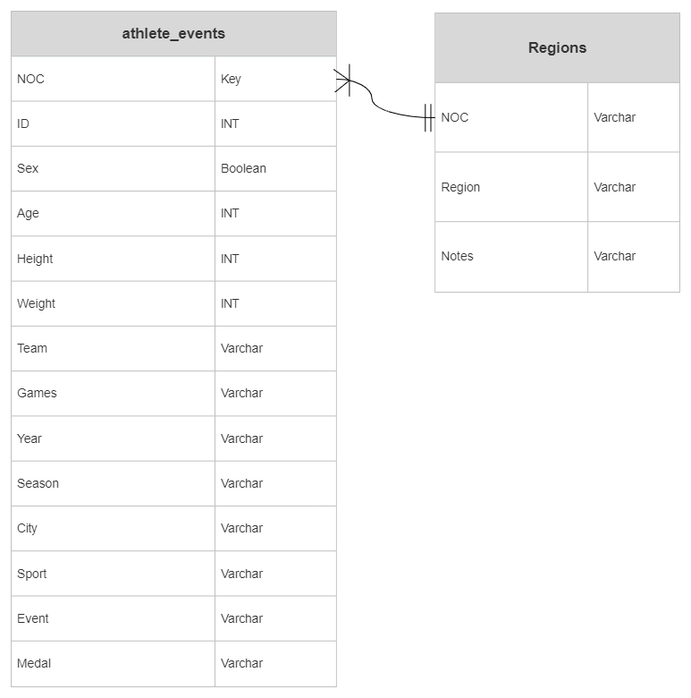
Entity Relationship Diagram

Slide 9
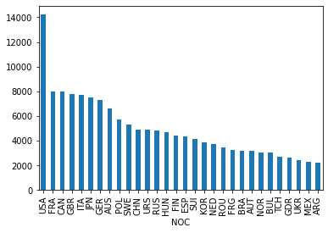
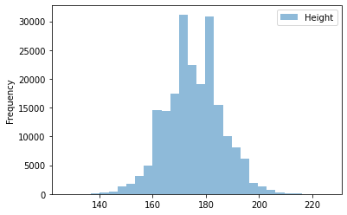
Initial Findings

Slide 10
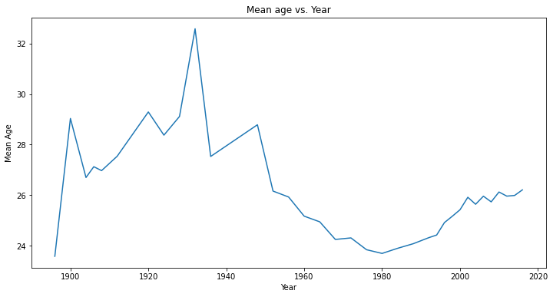
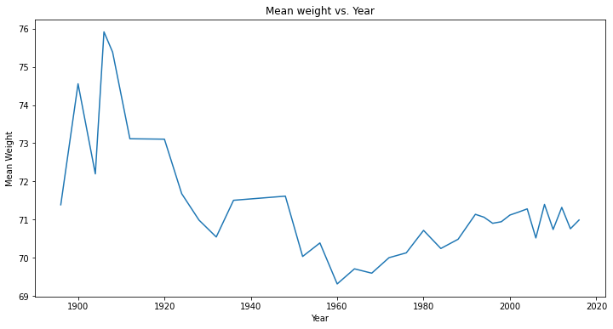
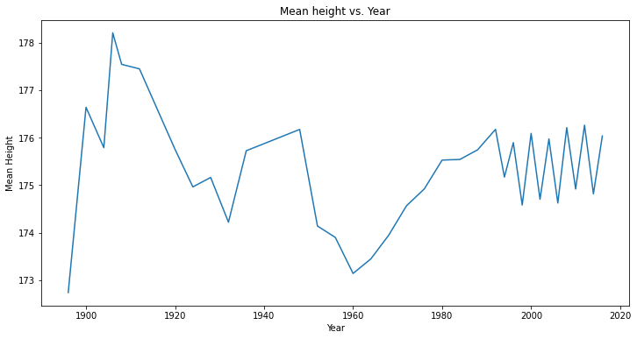
Initial Findings
The trend of age, weight and height all experienced a rise before 1920 and a drop then a rise. Average weight and average height are highly correlated, and both reached their lowest point in 1960, and then increased year by year. The decline before 1960 may be related to the world war. In the peaceful era, the height and weight of the contestants increased. These three indicators fluctuated slightly after 2000, but they tended to stabilize as a whole.

Slide 11
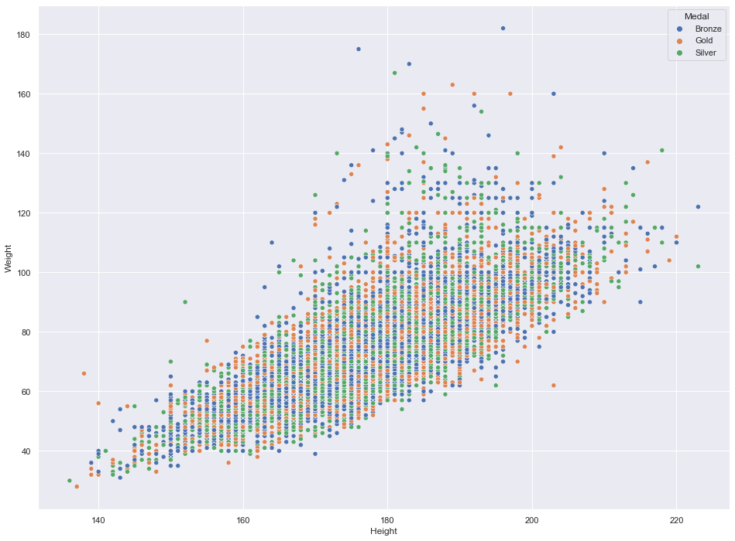
Initial Findings – Linear Relation

Slide 12
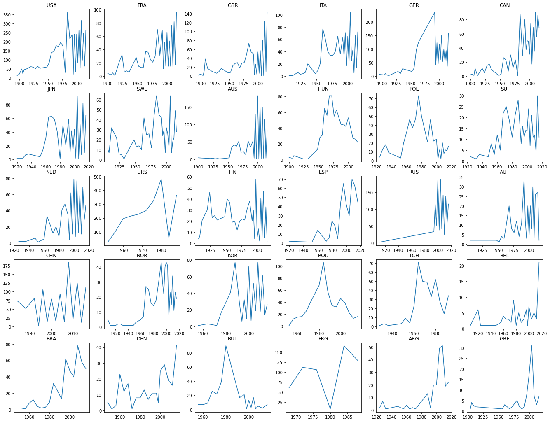
Previous Olympic medals of the top 30 countries
The performance of most countries is in a fluctuating situation, like USA, FRA, ITA
Some countries will have a prominent performance, but then return to normal, like ROU, GRE
The number of medals increased steadily in some countries, like BRA, ESP, DEN

Slide 13
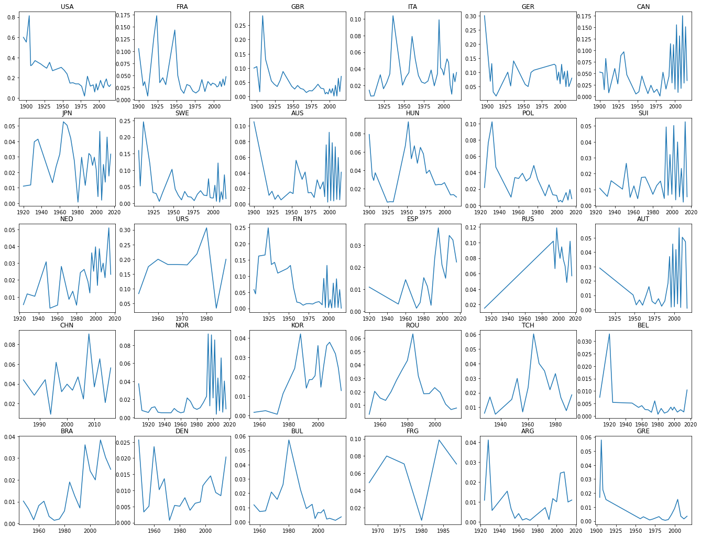
Previous Olympic percent medals of the top 30 countries
Although the top three countries have strong overall strength, the proportion of medals is declining
The sports strength of some countries has gradually increased and seized some medals

Slide 14
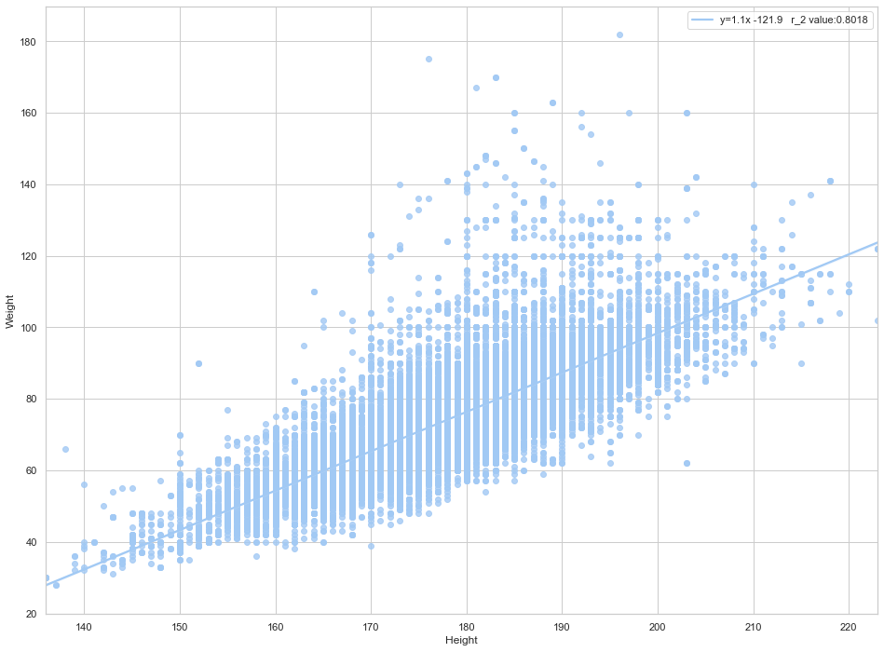
Deep Analysis – Weight vs. Height
linear formula: y = 1.1x – 121.9
r_2 value: 0.8018

Slide 15
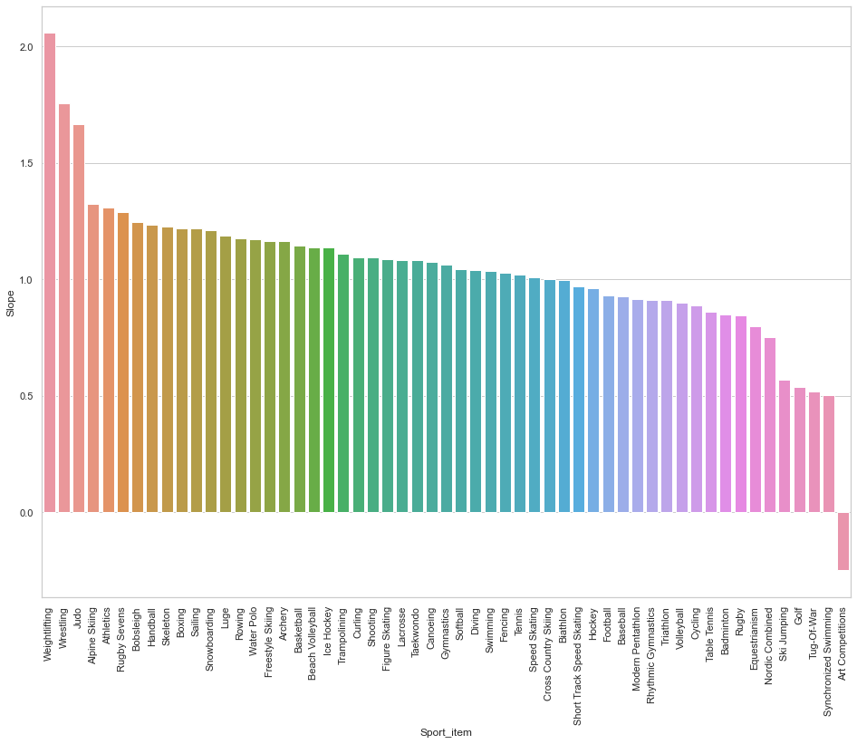
Linear regression for each sport
The highest sports in slope are weightlifting, wresting and judo
The three lowest movements of slope are Tug-Of-War, Synchronized Swimming, and Art Competitions
The weight height ratio of sports that need more confrontation will be a little higher, on the contrary, it will be a little lower

Slide 16
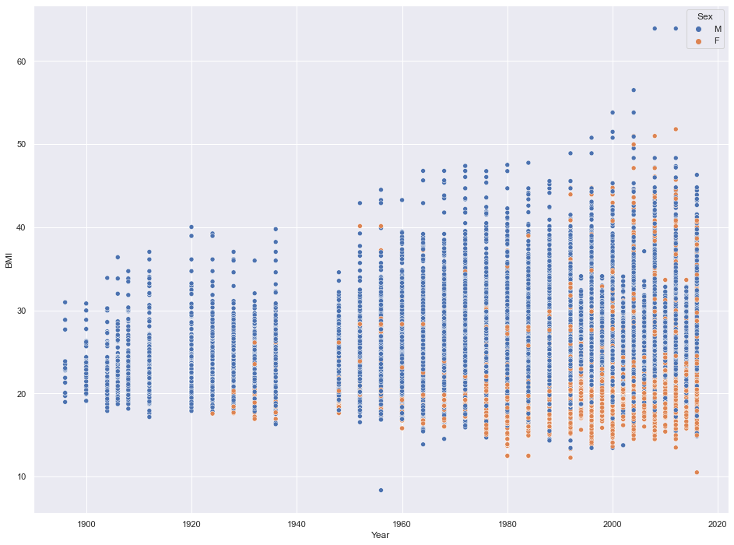
New Metric : Body mass index
Body mass index (BMI) is a measure of body fat based on height and weight that applies to adult men and women.
There were no female athletes in 1920 and before. Female athletes appeared from 1920 to 1970, and the BMI index was low.
There were no female athletes in 1920 and before. Female athletes appeared from 1920 to 1970, and the BMI index was low.

